Slide 1






1
MY BOOK RECOMMENDER APP
-Supriya Gir
Ironhack ML Project June 2026

Slide 2



2
HELLO, BOOKWORMS!
Imagine never running out of books you love.
In this presentation, we explore a recommendation system that learns the hidden connections between books, it’s description, authors, and suggests your next favourite read.
Using machine learning, we turn thousands of books into meaningful patterns — helping readers discover stories they didn’t even know they were looking for.

Slide 3

3
DATASET
Source
Goodreads and Openlibrary
Total Books:
5000 books from Goodreads ( 12 geners)
3500 books from Openlibrary (12 geners)
Important Variables:
title
author
genres
description

Slide 4
4
SOLUTION OVERVIEW
A hybrid recommendation system using NLP embeddings + clustering
Book Title +
Description +
Author
Embeddings
Clustering
Similarity ranking
Recommendations

Slide 5

5
DATA PROCESSING
Data Cleaning: Removed duplicates and handled missing values to ensure a high-quality dataset.
Normalization: Applied regex to clean titles and standardized text through case folding.
Embedding Generation: Used all-MiniLM-L6-v2 to transform text into 384-dimensional dense vectors.
Semantic Intelligence/Cosine similarity : These embeddings allow the system to recommend books based on semantic meaning rather than simple keyword matching.

Slide 6
6
RECOMMENDATION ENGINE
Book recommendation by favorite Book:
book cluster using HDBSCAN
compute cosine similarity
return top-N similar books
Book Recommendations by favorite Author:
average embeddings per author
TfidfVectorizer(Which words appear here a lot)
all-MiniLM-L6-v2(understands the meaning/semantics)
cosine similarity between authors
Book Recommendations by Mood(Extra)

Slide 7
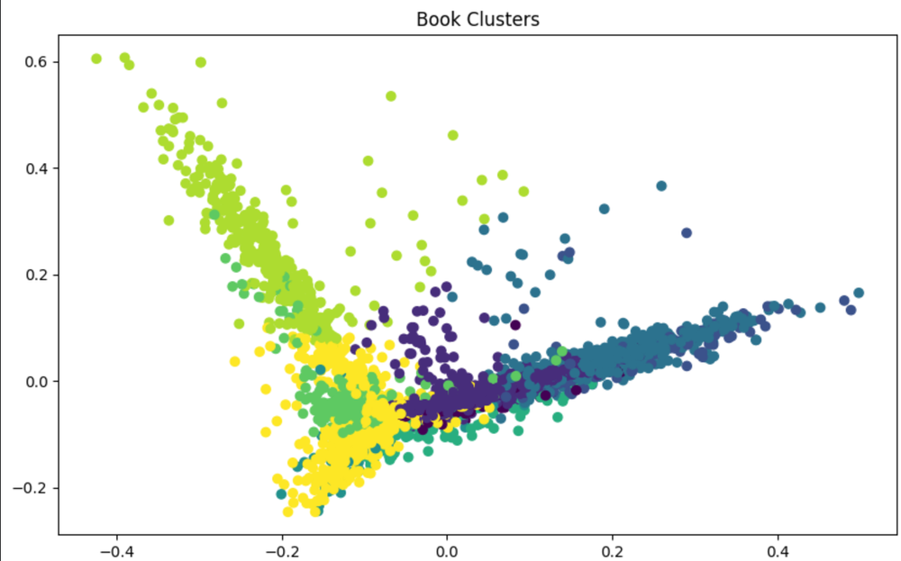
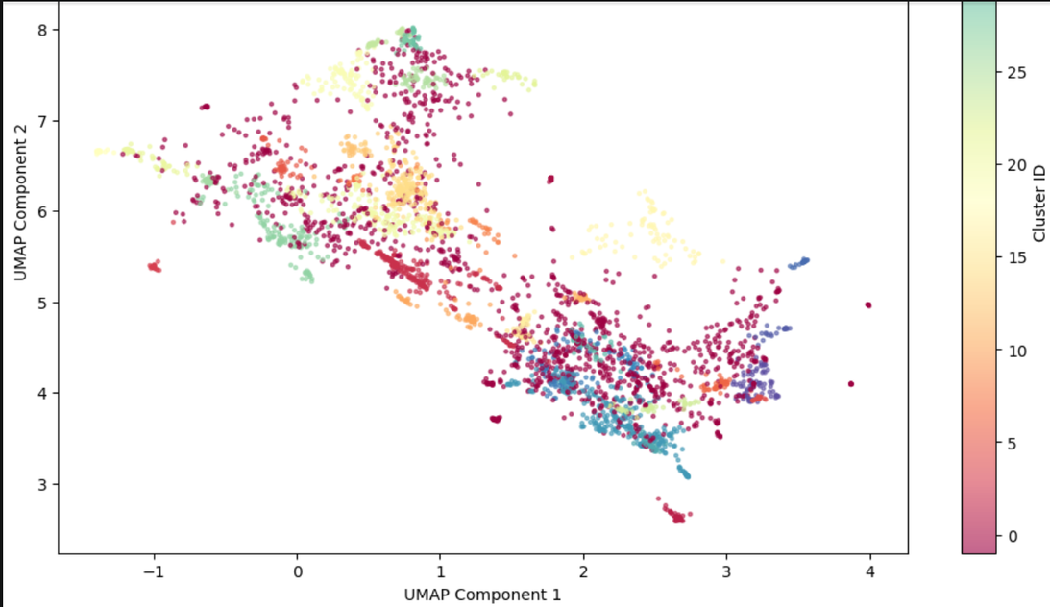
7
CLUSTERING (KMEANS/HDBSCAN)
SILHOUETTE SCORE: 0.56

Slide 8

8
BOOK SHOWDOWN!
STREAMLIT

Slide 9

9
CHALLANGES FACED
Data Collection and Cleaning: Book metadata is often inconsistent, incomplete, or contains "noise"
Selection on meaningful model
Handling High-Dimensional Embeddings
Understanding and implementing advanced machine learning concepts
User Interface Design
Data Loss and Recovery

Slide 10


10
THANK YOU
-Supriya Gir
Github Repo : Link

